Slide 1
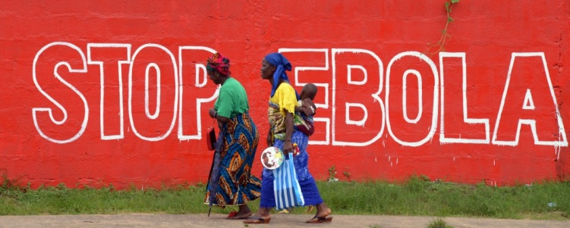
Ebola preparedness in België
Erika Vlieghe & Daniel Reynders
Nationale Ebola Coordinator
& adjunct-Coordinator

Slide 2
Overview
The epidemic in West-Africa
Preparedness in Belgium
Goals of this conference

Slide 3
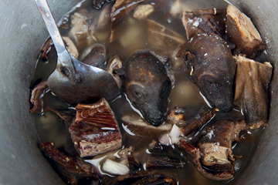
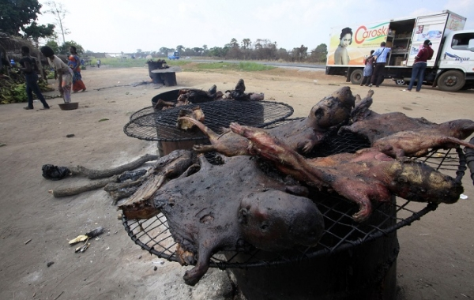
Ebola virus disease (EVD) outbreak in West Africa

Slide 4
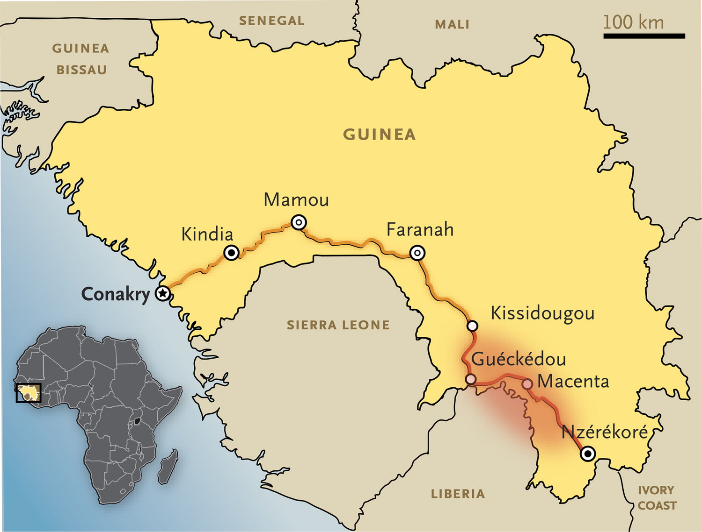
Baize S et al. N Engl J Med 2014. DOI: 10.1056/NEJMoa1404505
Notes:
Figure 1. Map of Guinea Showing Initial Locations of the Outbreak of Ebola Virus Disease. The area of the outbreak is highlighted in red. The main road between the outbreak area and Conakry, the capital of Guinea, is also shown. The map was modified from a United Nations map.

Slide 5
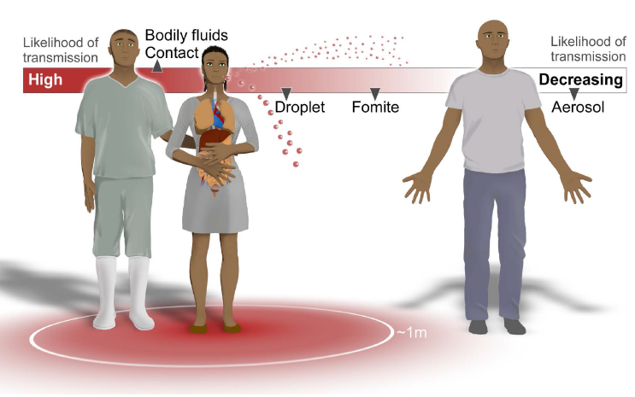
Ebola virus transmission
Direct contact with infected patients or cadavers
Mucosal surfaces, skin abrasions, parenteral introduction
Blood, vomit, excreta, genital and nasal secretions, sweat, urine

Slide 6
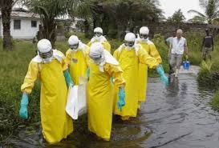
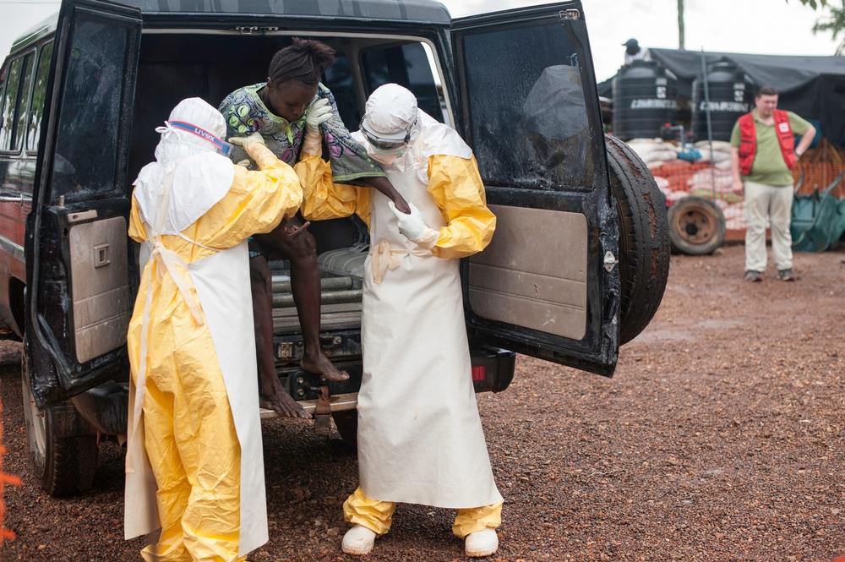
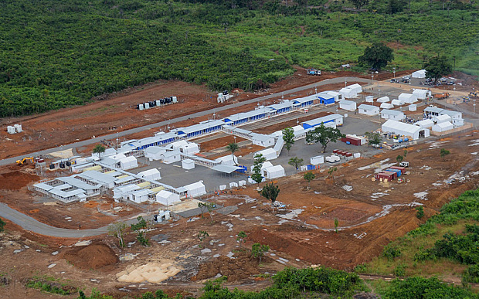
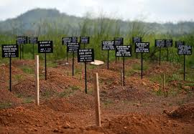

Slide 7
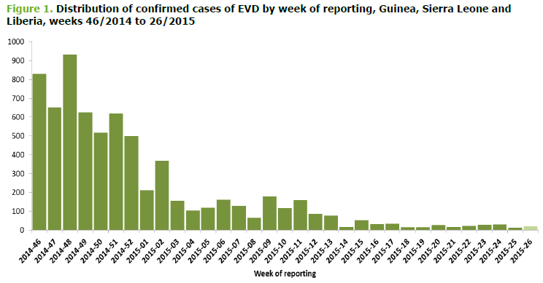
ECDC, Juni 215
20 september 2015:
Incidence < 10 cases/week
In total:
> 28.000 cases
> 11.000 death
November
2014
Januari
2015
Juni
2015

Slide 8
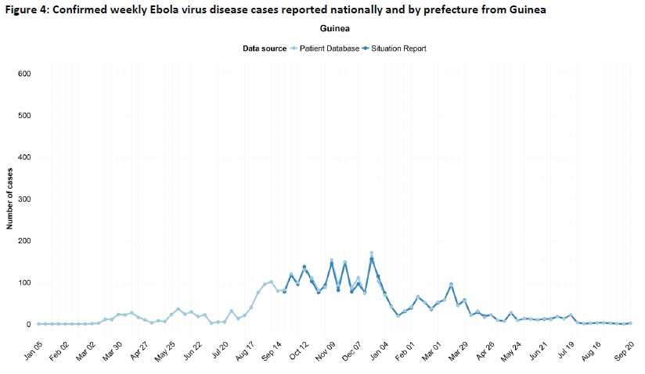
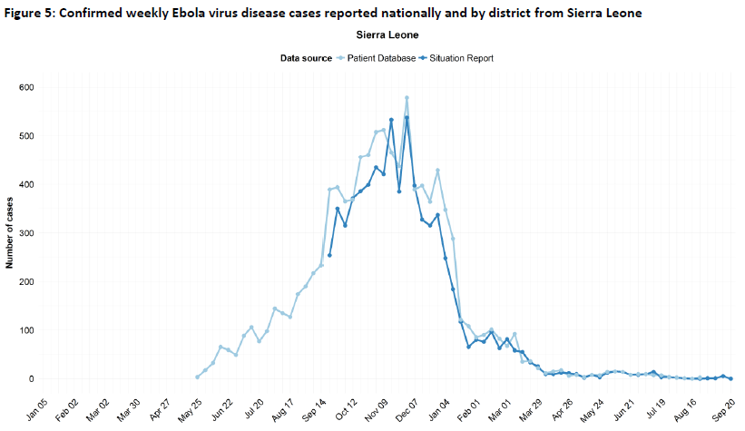
WHO update dd. 23 september 2015
Guinée
3 cases in past 21 days
Sierra Leone
6 cases in past 21 days
Liberia
‘ebola free’ 9 juni 2015
August 6 cases
‘re-free’ 3 september 2015

Slide 9
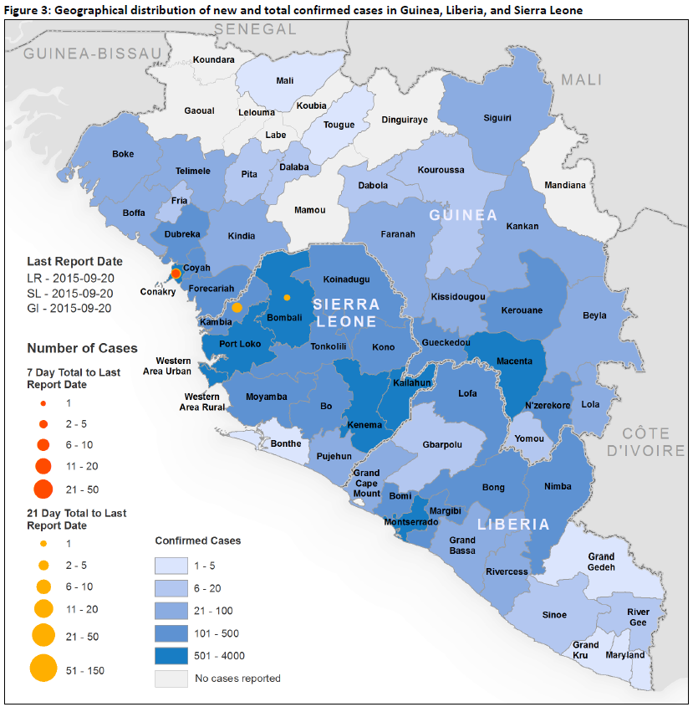
‘phase 3 response’
Enhanced surveillance
Rapid detection of new cases
Prevention of reintroduction of EVD
Vaccination

Slide 10
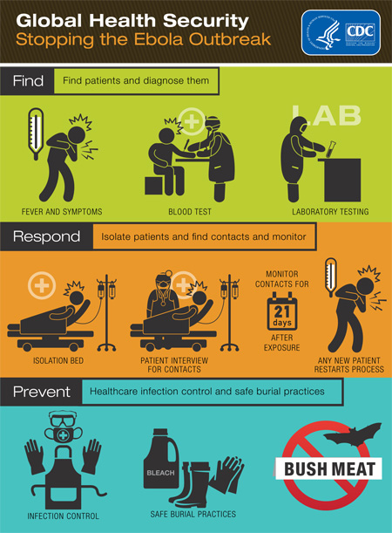
Response to an epidemic…
PATIENT
Isolation & treatment
CONTACTS
List and follow-up
HEALTH CARE WORKERS
Protection, training
POPULATION
Information, prevention
POLICY MAKERS
Surveillance
Multi-sectoral collaboration
Clear guidelines and measures correctes
Coordination
Centralised communication

Slide 11
What about Belgium…?

Slide 12
Ships
PRIORITY FIELD FOR ACTIONS
Airport
Trains
Local authorities
Schools
Community
Fedasil
employers
Army
Ambulances
GP’s
beds
Regional hosp.
Tertiary hospital
drugs
labs
Funerary services

Slide 13
Partners & interactions
Health authorities
Federal and regional
Scientific institutes
Institute of Tropical Medicine (ITG/IMT)
Institute of Public Health (WIV/ISP)
Hospitals
University hospitals
Regional ( non-university) hospitals
Expert and scientific bodies
Superior Health Council (HGR/CSS)
GP associations (Domus Medica, SSMG)
(Para)medical professional organisations
NGO’s
Médecins sans Frontières (MSF, AzG)
Other governmental services
FAGG
Army
BiZa/CGCCR/Civil protection
Fedasil/DVZ
Customs
Police
Private partners
Brussels Airlines
Brussels Airport
Ambulance services
Funeral services
…

Slide 14
Crisisteam Ebola &
National
Ebola Coördinator
Werkgroep Logistiek
Werkgroep Communicatie
Werkgroep Experten
Werkgroep Preventie en Controle
Werkgroep Ziekenhuizen

Slide 15
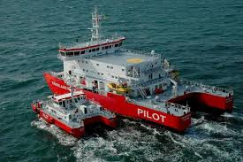
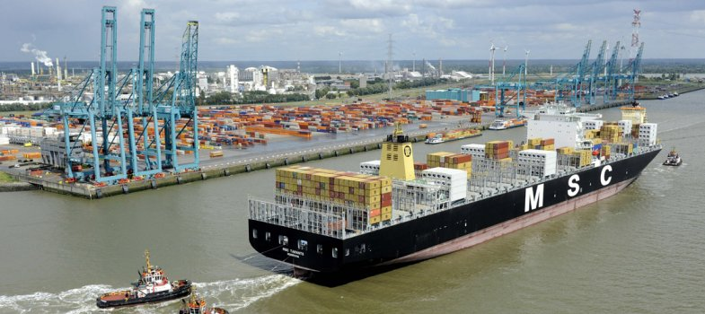
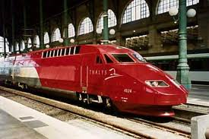
‘Entry points’ for the country…
Temperature screening
Safer cleaning procedures
Procedures in case of ill traveler
Exercises

Slide 16
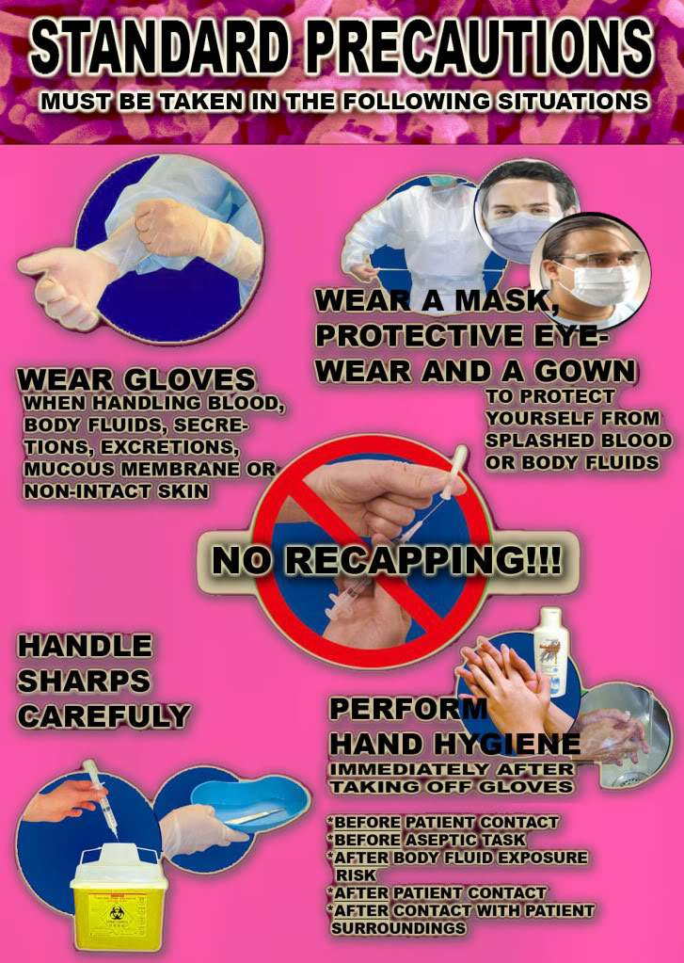
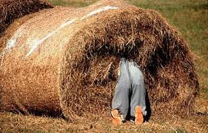
Triaging and case finding in Belgium

Slide 17
Heeft mijn patient Ebola-infectie?
Stel de 3 vragen:
In epidemisch gebied verbleven in de afgelopen 21 dagen?
Koorts +/- andere klachten (braken, diarrhee, bloedingsneiging,…)?
Blootstelling in risicogebied aan zieken, lichaamsvochten?
Zorgvuldige en gedetailleerde anamnese
Stel patient gerust dat goede zorgen altijd gegeven worden
Overleg met arts infectieziektenbestrijding

Slide 18
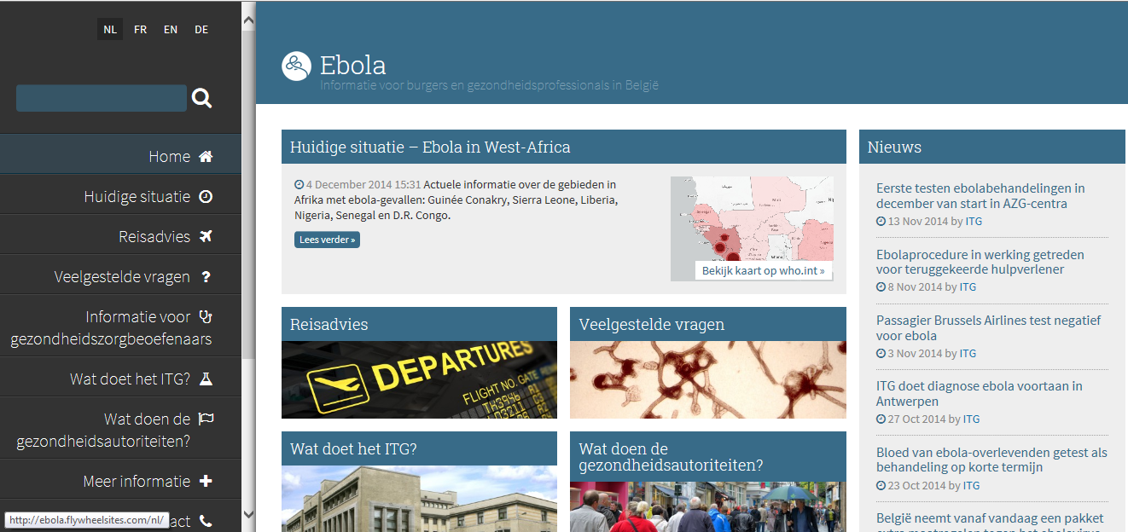
Procedures-procedures-procedures
www.info-ebola.be

Slide 19
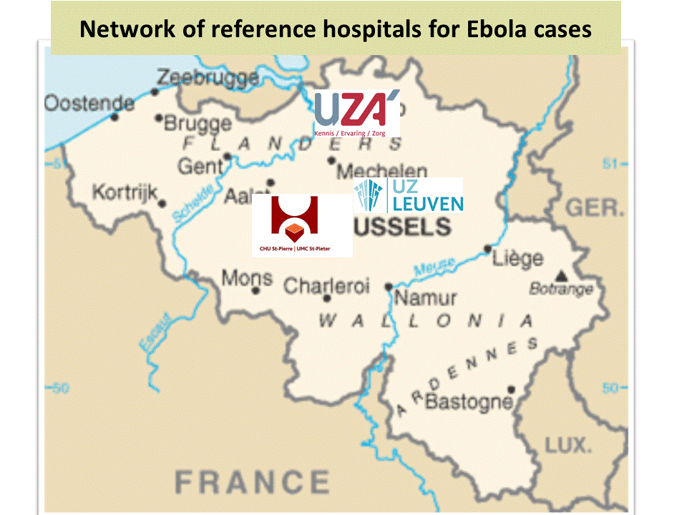
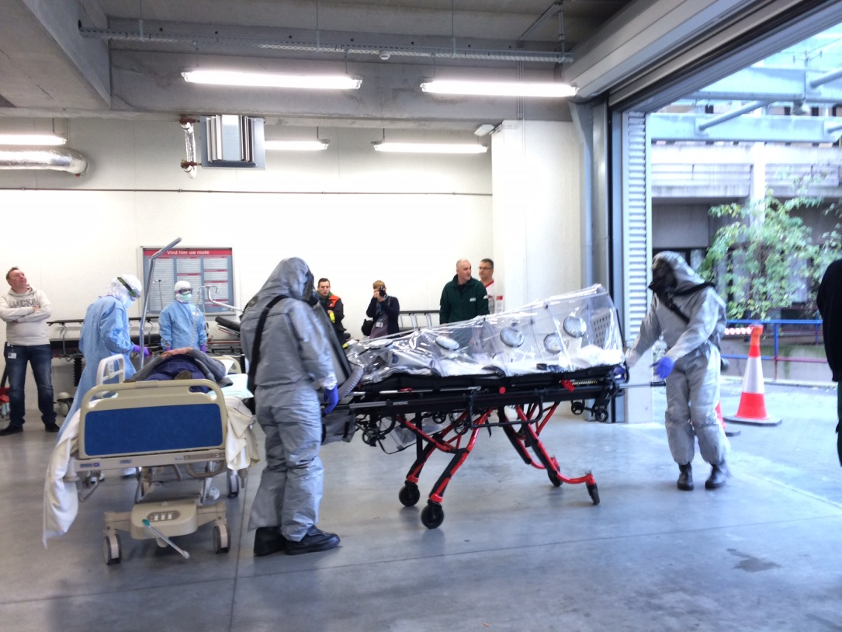
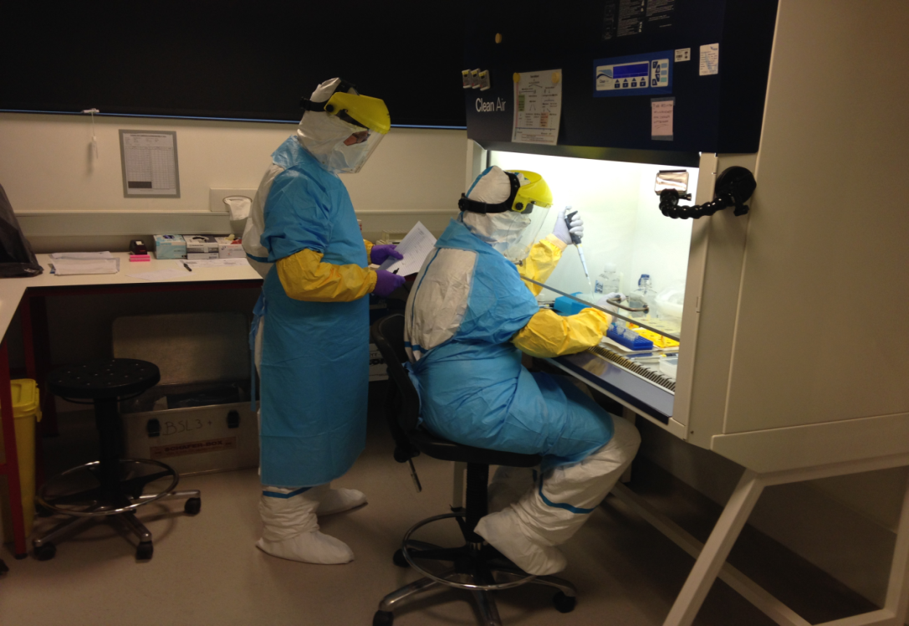
3/2014 – 9/2015:
13 genuine ‘probable cases’ ➔ all tested negative
(many more ‘suspect’ but not meeting all criteria)

Slide 20
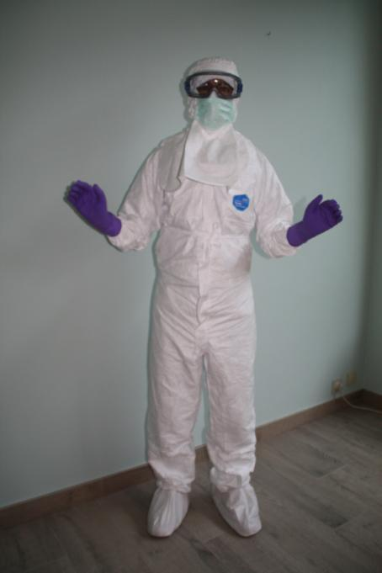
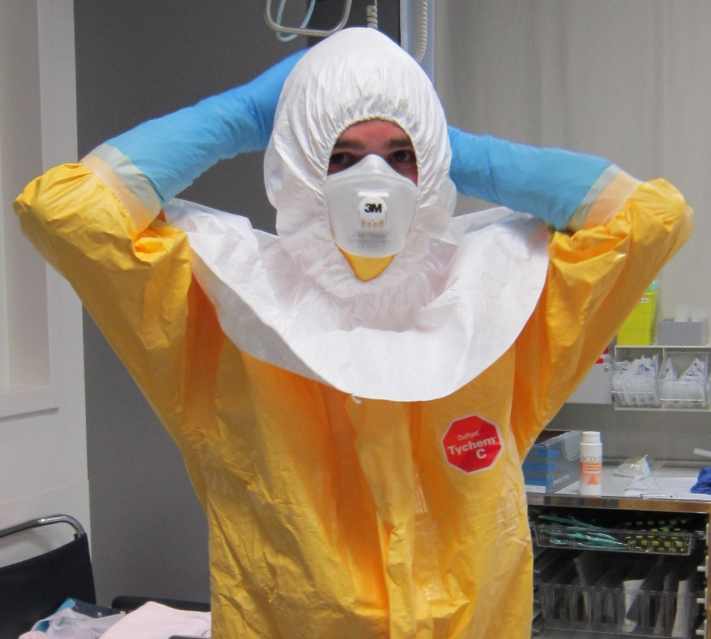
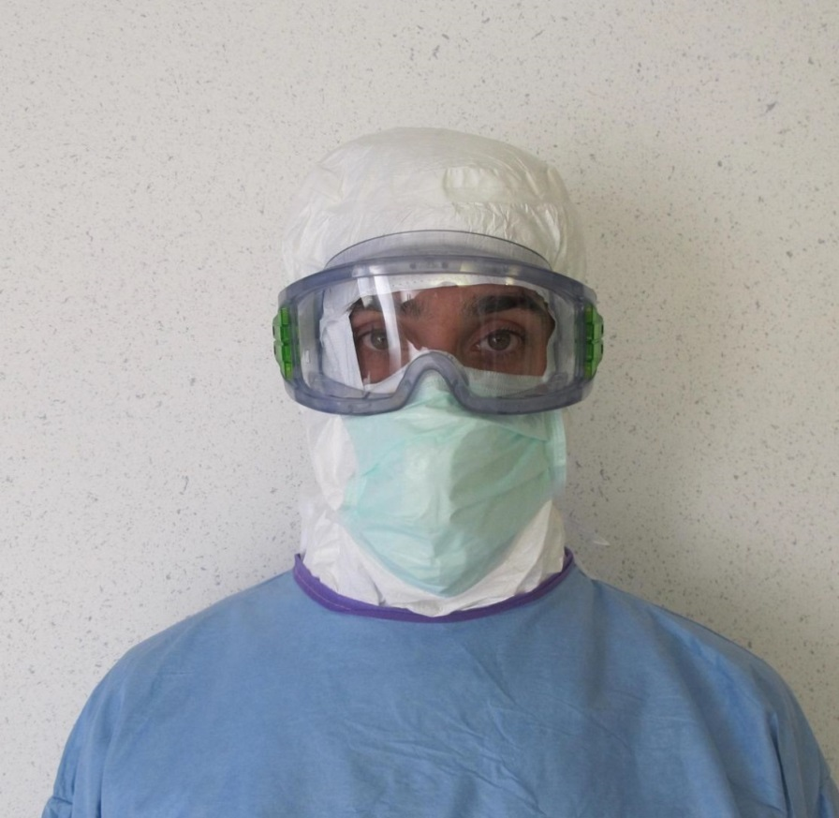

Slide 21
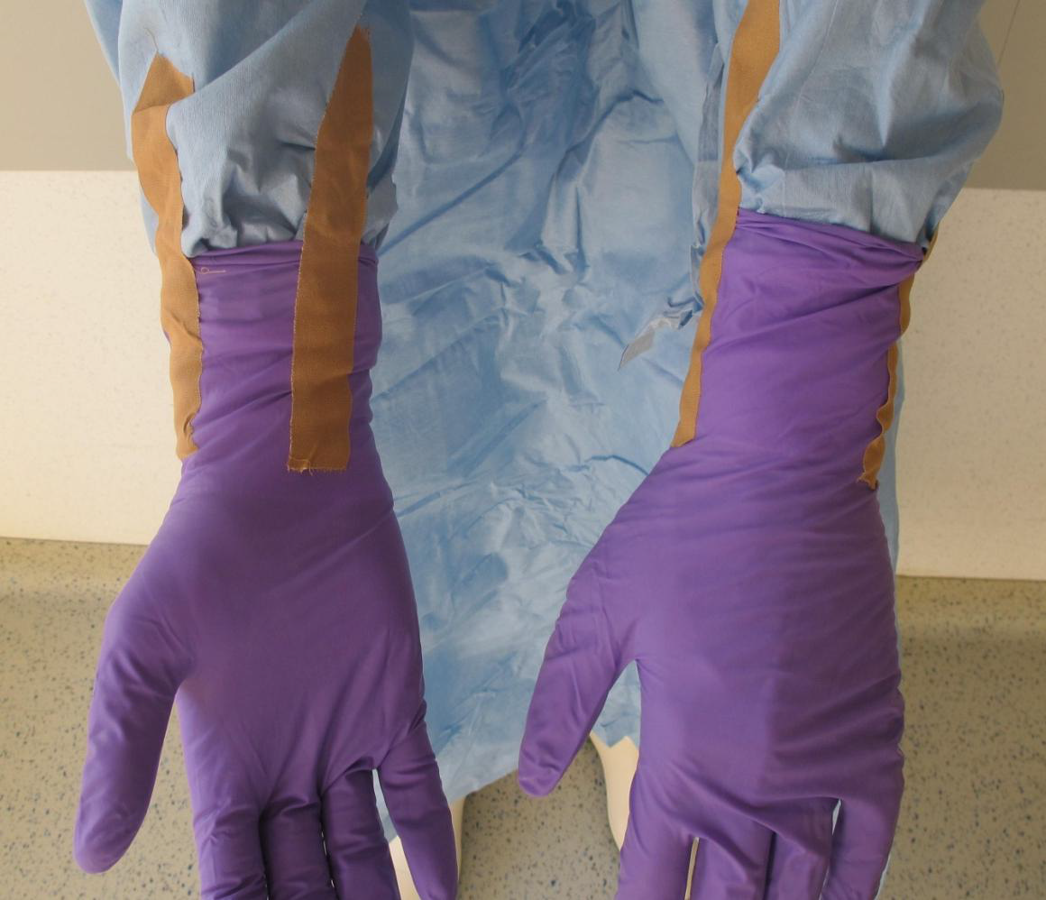
Glove issues…
PPE: evidence based medicine???

Slide 22
Taking care of returning HCW and contacts…
No blanket ‘quarentaine’
But:
close collaboration with NGO/employer of returning HCW
procedures for high risk exposure ➔ PEP

Slide 23
Centralised communication
Referring hospital
Airport
NGO/employer
GP
Public health dr
Reference hospital
Asylum centre
FOD/SPF
ITM
cabinet
press

Slide 24
Ebola is about challenging balances
Individual health >< public health
Effective treatment >< Staff safety
Pragmatism >< maximal safety
Overdiagnosis >< underdiagnosis

Slide 25
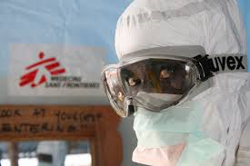
Ebola epidemic (2013)- 2014-2015
Time to look in the mirror…
What was good? What has to be improved…?

Slide 26
ECDC peer review
March 2015
‘Overall a lot of work has been done in the past few months by the entire team’
‘We appreciate the pragmatic approach building on existing structures’
‘Belgian experience could serve as a model for other countries’
Working points:
Strengthen/excercise preparedness at first line services
Compare airport experiences with UK, France, Morocco
Use ‘legacy’ to prepare for future threats
…

Slide 27
Towards a generic preparedness plan…
Which entry point policy?
Scientific evidence versus perception of control
How to prepare first line care for rare events?
Preparedeness in targeted vulnerable populations (e.g. asylumcentres)
How to strengthen surveillance and lab capacity
Patient transport ➔ part of CBRN preparation?
Which HLIU hospital capacity for Belgium?
…
NATIONAL CONFERENCE:
FROM EBOLA TO GENERIC PREPAREDNESS
30 SEPTEMBER 2015

