Slide 1
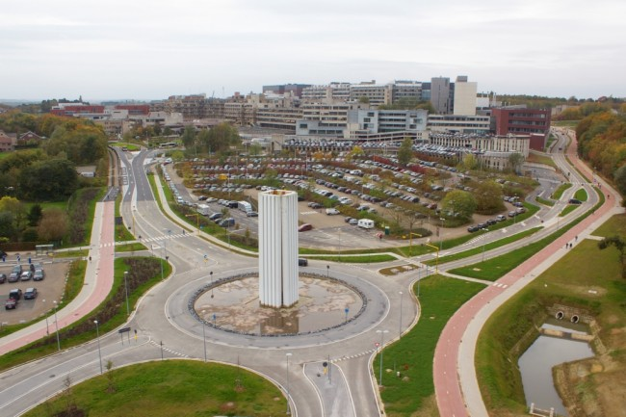
Ebola: patient care in UZ Leuven: experience, issues and questions
Dr. Paul De Munter
Algemene inwendige ziekten/infectieziekten

Slide 2
Contents
Balance transmission risk <-> care/cure
Restrictions to care
Use of diagnostic and supportive equipment
Use of experimental treatments
Questions for the discussion

Slide 3
Introduction
N=0
Experience is a big word…:
 | Belgium | UZ Leuven
Confirmed ebola cases | 0 | 0
Unconfirmed suspected cases | 13 | 2

Slide 4
Balance transmission risk <-> care/cure
1
To prevent further infections
To prevent panic
3
To relieve symptoms
To increase survival
Intensive care: ventilation, dialysis
Isolation in HIDU
Advanced care: surgery, ECMO
Case undiagnosed in society
Intensive care: monitoring, lab tests, deep venous catheters
Simple isolation measures
Supportive care: liquids, oral medication
2
To prevent disruption of hospital services
To prevent hospital staff infections

Slide 5
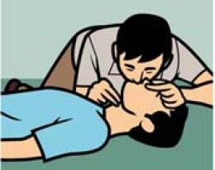
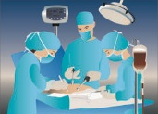
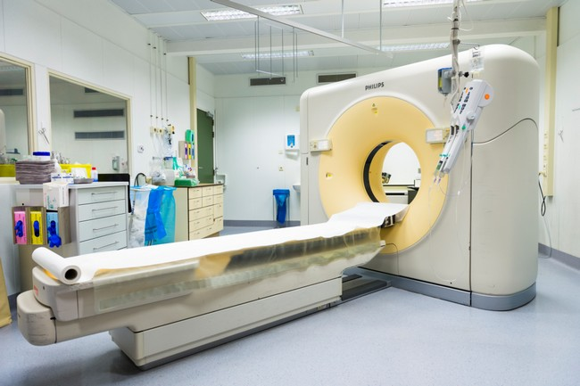
Restrictions to care in UZ Leuven
No reanimation if no staff in PPE (no a priori DNR-code)
No surgery in operating theatre
(Small surgery in unit to be considered)
No XR in radiology dpt/No CT/No MRI
(bedside XR and US possible)

Slide 6
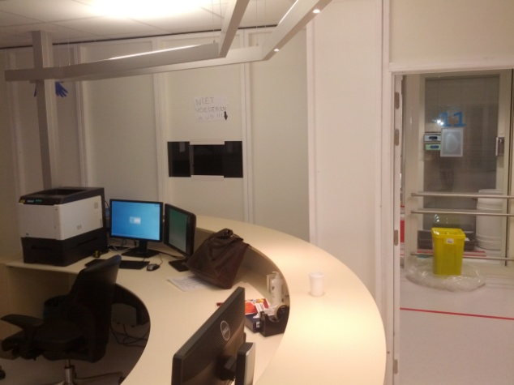
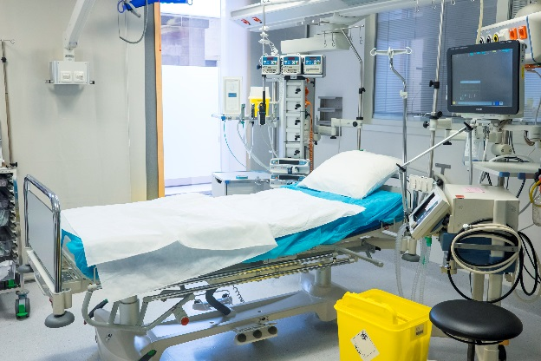
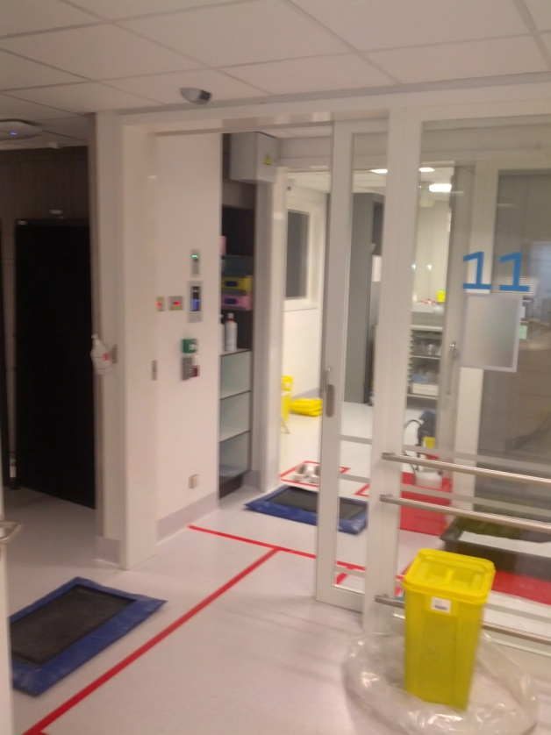
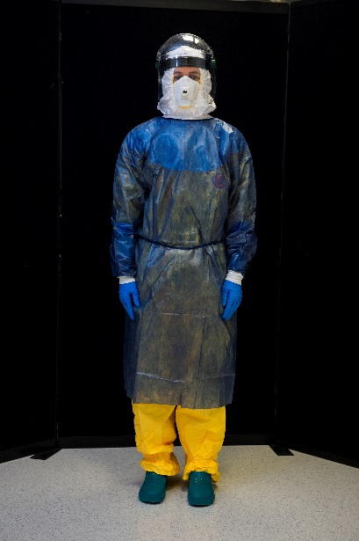
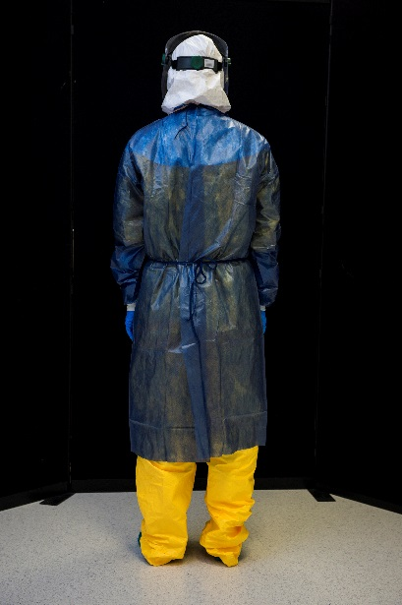
Organisation of care in UZ Leuven
Immediate hospitalisation of all suspected and confirmed cases (wet and dry) in a special unit in the medical intensive care
Care by (PPE) trained staff only: MICU (and some PICU) nurses, all senior medical intensivists (4) and pediatric intensivists and all infectiologists (4)

Slide 7
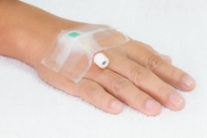
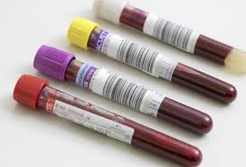
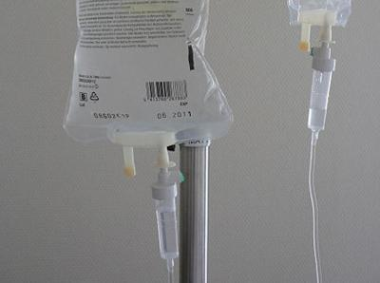
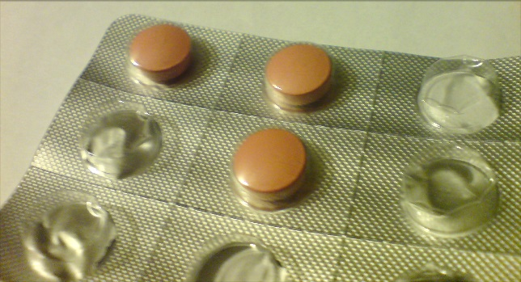
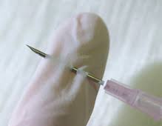
Organisation of care in UZ Leuven
Once in unit, one venipuncture procedure for blood drawing, leaving a heparin lock for further blood samples/IV treatment
No DVC (dialysis catheter) until clinical indication
Antimalarials and broad-spectrum antibiotics started immediately, if clinical indication
All invasive procedures: evaluate risk vs expected benefit/prognosis

Slide 8
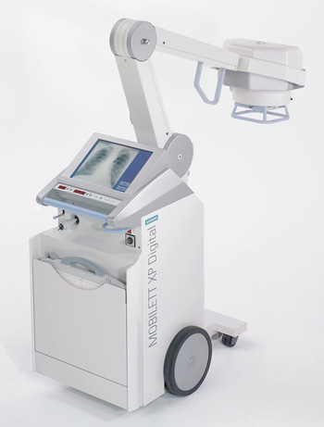
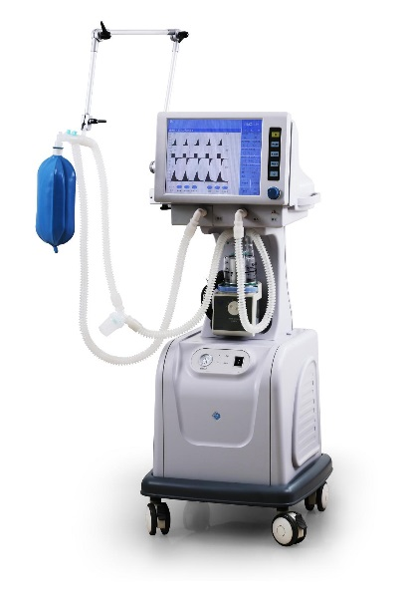
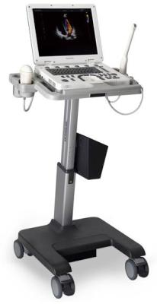
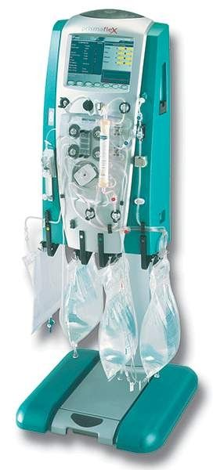
Organisation of care in UZ Leuven
Diagnostic and supportive equipment:
Equipment in isolation unit as soon as needed, then ‘never’ out
Monitoring equipment (vitals)
Arterial blood gas analyser
Ventilator
Continuous veno-venous hemofiltration
Mobile XR
Ultrasound
Other blood tests in L3+ lab
PCR ebola to ITM-Antwerp

Slide 9
Experimental drugs
experimental = benefits/risks unknown
“Very high mortality => benefit/risk drug less relevant”?
Most patients in Europe received one or more experimental drugs (pressure to do ‘something’ enormous)
Prepare availability of drugs:
Working group with FAGG
Ministerial decree
Connections with WHO and pharmaceutical companies
Which drugs:
Of those that are available/obtainable: those with most evidence for activity/evidence for least toxicity

Slide 10
Questions:
How many reference hospitals do we need?
Isolate in ICU or non ICU?
Ebola suspicion not confirmed: use formal criteria or clinical judgement?
How far should we go with intensive care?
Should we use experimental drugs? Which ones?

Slide 11
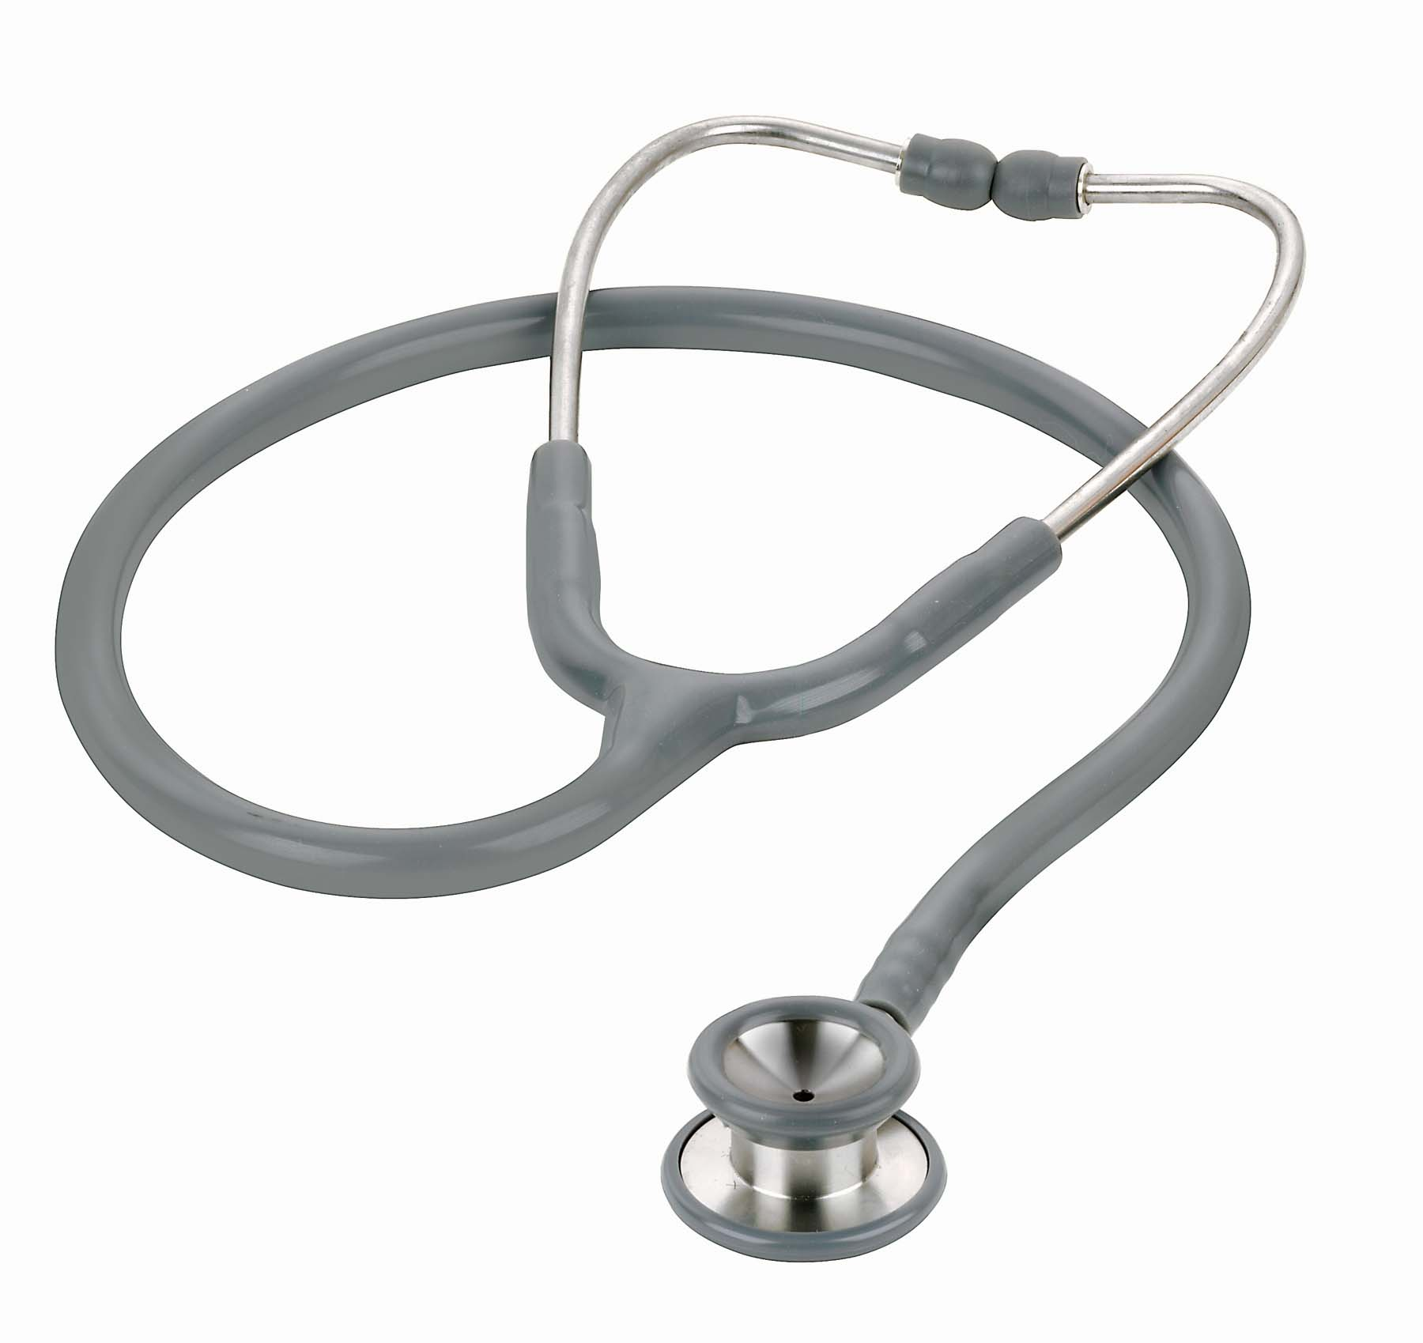
What with the stethoscope?
Write a procedure for using a stethoscope wearing PPE…

