Slide 1
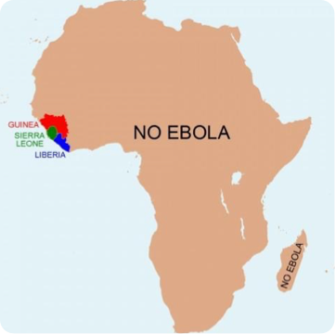
Brussels airlines Contingency plan ebola
Sophie van zaelen
Health, safety environment manager
Brussels airlines
September 3O^{th} 2015

Slide 2
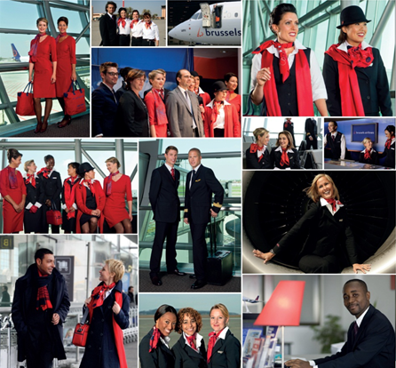
OUR COMPANY PROFILE
3,500 employees (45 different nationalities)
We generate 10,000 indirect jobs
More than 80 destinations : 64 in Europe
19 in Africa
2 in the US
Number of guests : In 2014: 6.6 million (+13% PY)
JAN-JUN 2015: +12%
47 aircraft
8 A330 18 A319
7 A320 12 AVRO RJ100
2 DASH 8-Q400

Slide 3
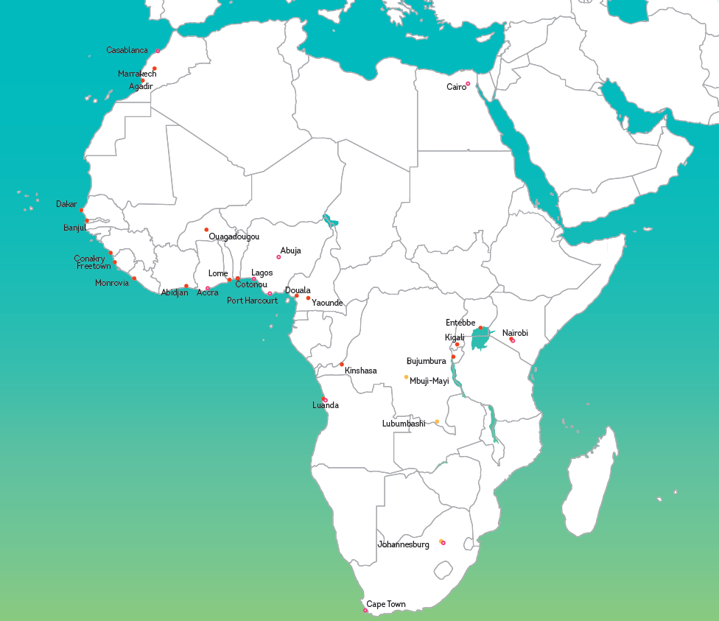
AFRICA IS PART OF OUR DNA
90 years of aviation experience
Up to 500 employees in Africa
19 destinations (90 connections per week)
More than 800.000 guests a year
Important freight activity
Strong offer to West Coast of Africa, Great Lakes region and market leader to Congo
Seamless connections with the European and US network
Important traffic between the US and Africa
Next to the company CSR-projects, many employees are committed to Africa and have their own projects and
initiatives supported by the f oundation

Slide 4
THE LAST TO LEAVE AND THE FIRST TO COME BACK
We have a tradition: we stay committed to the African continent in good and bad times
Ebola is no exception to this tradition
Since April 2014 we are monitoring the situation in the Ebola stricken countries in close cooperation with our medical department and the respective authorities and institutions
A thorough daily risk-assessment has been put in place in order to keep our operations alive
Despite difficult circumstances and an increased complexity of our operations, we decided together with our staff and union delegates to continue with our operations

Slide 5
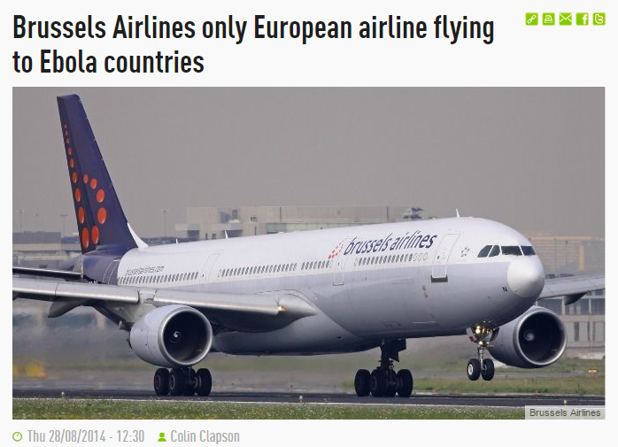
SUDDENLY WE WERE THE ONLY EUROPEAN CARRIER LEFT
March 2014: Major Ebola outbreak in Guinea
The virus rapidly spread over to neighboring countries Sierra Leona and Liberia
August 8th 2014: WHO declares the epidemic to be an international public health emergency
Late August 2014: The disease had spread to Nigeria, and one case was reported in Senegal
August 28th 2014: Brussels Airlines remains the only European airline to operate to all three countries
September 25th 2014: A first case in the US
January 2015: First positive effects of the international health-support are visible
May/September 2015: Liberia Ebola free
Deredactie.be

Slide 6
EBOLA, IT’S ALL ABOUT TAKING RESPONSIBILITY
We cannot act as if it’s none of our concern. We need to keep the lifeline working.
At the same time, the security of our guests and staff members remain always our highest priority .
As long as our daily assessments allows us to fly, we continue to do so, as we see it as our humanitarian responsibility to not isolate these countries.

Slide 7
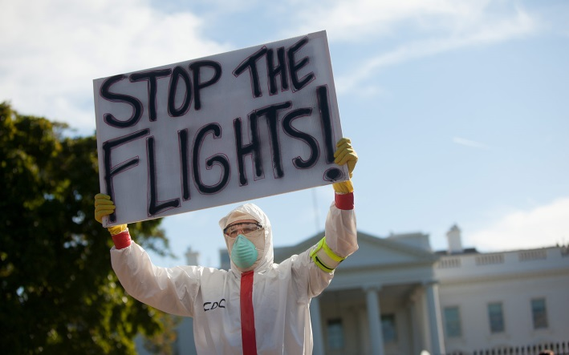
HYSTERIA ALL OVER THE WORLD

Slide 8
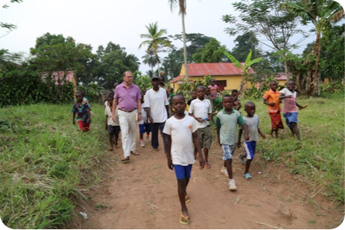
EBOLA AND THE EPIDEMIC OF MASS HYSTERIA
“There is an epidemic of Ebola in West Africa and then there is a second epidemic, an epidemic of mass hysteria. I am convinced that we can make the West-African countries Ebola free. Fighting against the mass hysteria epidemic is the most difficult task.”
Baron Peter Piot
(Belgian microbiologist known for his research into Ebola and AIDS, December 2014)

Slide 9
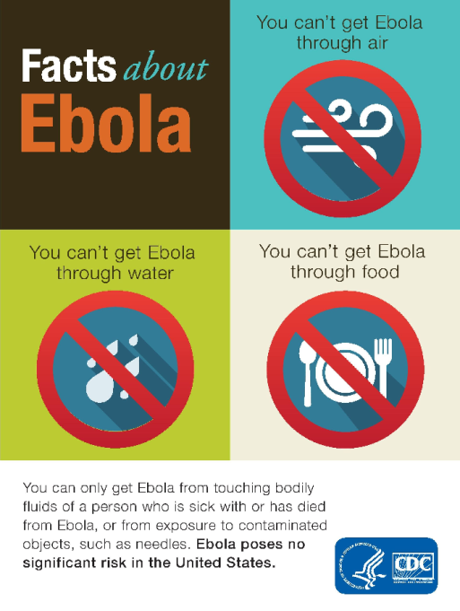
CLOSE COORDINATION ON INTERNATIONAL LEVEL IS KEY
Transparent and continuous communication based on facts and experts’ information
Educate and inform the public opinion based on facts and no sensationalism
Secure that all stakeholders are well informed about latest updates and processes
Grant international alignment of processes to secure the efficiency of the measures taken
Lungi International Airport
Roberts International Airport
Gbessa International Airport
Notes:
Keep rational thinking ahead of emotional reactions

Slide 10
PROCESSES HAVE BEEN ADAPTED
Review of our flight schedules
Change of crew base
Inform & train ground and flying staff with the support of experts, professional health workers and our own medical service
Open social dialogue with internal and external stakeholders
Establish a list of crew members who are willing to operate the flights
Establish specific aircraft cleaning and disinfecting procedure
Daily checks of measures in place and continuous improvement

Slide 11
PROCESSES HAVE BEEN ADAPTED
Safety precautions taken at Guinea, Sierra Leone and Liberia airports
Support airport exit screening of passengers by local ministries of health & airport authorities
Primary screening
Secondary screening
‘Risk’ passengers are denied boarding a flight
Luggage check for perishables as prevention of leaking bags (sanitary reasons)
Distribution of information flyers and Passenger Locator Cards (PLC) at departing gates
Notes:
(supported by WHO, CDC…)
PRIMARY SCRENING: body temperature measurement, visual check on symptoms and signs of Ebola Virus Disease (EVD), filling out of questionnaire enquiring about passenger’s health and possible exposure to the virus
SECONDARY SCREENING: travellers with fever or presenting a potential risk of Ebola infection are submitted to a medical examination
‘Risk’ passengers are denied boarding a flight

Slide 12
PROCESSES HAVE BEEN ADAPTED
Safety precautions and standard operating procedure in-flight
Adapt standard operating procedure with specific guidelines in case a passenger is showing symptoms of EVD:
Isolation of ill passenger
Assessment of possible exposure to the virus, use of checklist, notification of positive outcome to health authorities
Upon arrival at Brussels Airport, medically trained ground staff and health authorities take charge and will decide on further steps as per standard procedure
Equip all long-haul and medium-haul aircraft with a dedicated PPE kit, non-contact thermometer, alcohol based hand sanitizers

Slide 13
PROCESSES HAVE BEEN ADAPTED
Safety precautions at Brussels Airport for directs flights from Guinea, Sierra Leone and Liberia
Entry screening of passengers as an additional precaution to detect travellers with fever upon arrival in Brussels
Implemented October 20, 2014
All passengers, in transit and with final destination Brussels
Process and procedures by Public Health Belgium
Luggage screening on arrival in Brussels by a specialized firm:
leaking bags are destroyed and contaminated bags disinfected
Notes:
Check of Passenger Locator Card (enable contact tracing)
Body temperature measurement
When exceeding 38°C, a nurse will conduct a further assessment
Outcome of assessment is positive: consultation of the airport doctor who will decide on further steps as per standard procedure
+ SOME FIGURES

Slide 14
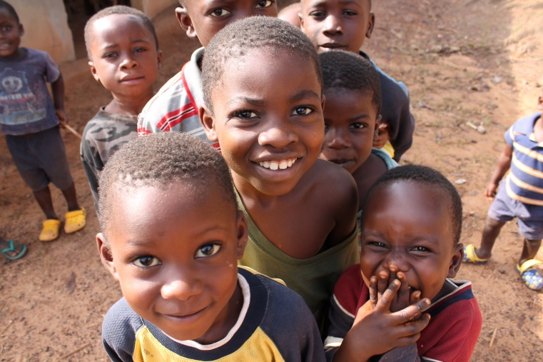
TOWARDS THE END OF EBOLA & THE WAY TO NORMAL OPERATIONS
Within 12 months, we welcomed 90,000 guests on board of our flights to Conakry, Monrovia and Freetown (mainly health-care workers)
Up to now, we didn’t have one single contagious passenger on board
In the few suspicious cases, the procedures in place have at all times strictly been respected
As the situation has very much enhanced, we have increased our frequencies to Monrovia and Freetown

Slide 15
THE SITUATION IS ENHANCING, BUT IT’S NOT TOTALLY OVER YET…
We see it as our responsibility to continue supporting the three countries and to spread the word about the beautiful African continent
#AfricaIsNotEbola
www.africaisnotebola.com
https://www.facebook.com/AfricaIsNotEbola

