Slide 1
Ebola: Lessons learned. How to be better prepared ?
BESCHERMING VAN NATIONALE TOEGANGSPOORTEN
PROTECTION DES POINTS D’ENTREE NATIONAUX
30/09/2015

Slide 2
BESCHERMING VAN NATIONALE TOEGANGSPOORTEN / PROTECTION DES POINTS D’ENTREE NATIONAUX
Panel :
Mme Sophie Van Zaelen,
Directeur Sécurité, Santé et Environnement
Brussels Airlines
Cpt Rejane Gijssen,
Chef de service Nautique, Maritime Rescue and
Coordination Centre – Search and Rescue (MRCC-SAR)
Modérateur et rapporteurs :
Dr Dirk De Groof,
Cellule Public Health Emergencies, SPF Santé publique, Sécurité de la Chaîne alimentaire et Environnement
Dr Paul Pardon
Cellule Public Health Emergencies, SPF Santé publique, Sécurité de la Chaîne alimentaire et Environnement
Dr Luc Tsachoua
Cellule Public Health Emergencies, SPF Santé publique, Sécurité de la Chaîne alimentaire et Environnement

Slide 3
Discussion points
1.What should be the conditions to stop or phase out the entry screening measures at Brussels Airport and international seaport ?
2. Could we benefit from international alignment of processes to secure the efficiency of the measures taken ? (example: entry screening process/ procedures and measures differ in US, within EU in Belgium, UK, Italy … )
And which measures should be taken to establish such alignment ?
3. How can we better educate and inform travelers in case of a public health emergencies such as the current EVD outbreak in West-Africa ?
4. How can we optimize the PLC filling ?

Slide 4
Positive points
Decision to continue air travel to affected countries
Harmonisation and centralization of the communication (speaking with one voice)
Positive effects of meetings and exercises (with all partners)
Good collaboration between the stakeholders in air and sea ports (SN, RMCC, Brussels airport, Saniport, Swissport, Police, etc.)
Good follow-up of possible cases identified during flights
Positive effect of the nomination of a National coordinator (immediatly active on the field)

Slide 5
To improve / To do
The nomination of National coordinator should have been earlier (to avoid the contagious mass hysteria)
PLC is too complicated to fill in and handicaps movement of passengers.
Linking data bases for the filling of MDH (between customs, port authorities and MRCC) ;
The quarantine law for ships is obsolete (fits no more with the reality)
Harmonization of international procedures (for screening)
Develop conditions to face out screening
Assessment of the impact of entry screening
Develop a procedure of control for railways and roads trafic.

Slide 6
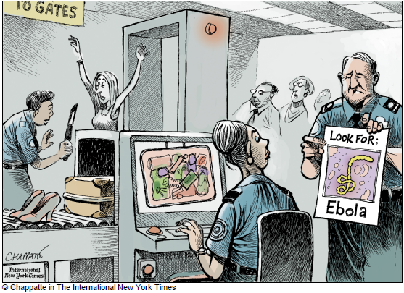
Thank you for your kind attention… Questions ?

